Slide 1
Multiplexer or DE-multiplexer
Presentation on

Slide 2
Multiplexer
A multiplexer is a combinational circuit that has 2^{n} input lines and a single output line.
A multiplexer is also treated as Mux.
there are n selection lines and 2^{n} input lines.

Slide 3
Types of Multiplexer
2×1 Multiplexer
4×1 Multiplexer
8×1 Multiplexer
16×1 Multiplexer

Slide 4
2×1 Multiplexer
In 2×1 multiplexer, there are only two inputs, i.e., A₀ and A₁.
1 selection line, i.e., S₀ .
single outputs, i.e., Y.

Slide 5
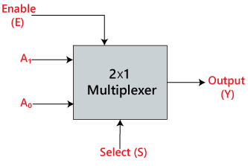
Block Diagram of 2×1 Multiplexer

Slide 6
Truth Table 2×1 Multiplexer:
Selection Lines | INPUTS |  | OUTPUT
S₀ | A₀ | A₁ | Y
0 | 1 | 0 | A₀
1 | 0 | 1 | A₁

Slide 7
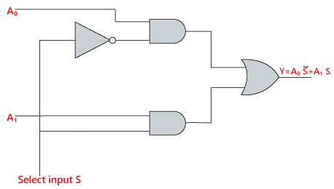
Logic Circuit 2×1 Multiplexer

Slide 8
4×1 Multiplexer:
In the 4×1 multiplexer, there is a total of four inputs, i.e., A₀, A₁, A₂, and A_{3.}
2 selection lines, i.e., S₀ and S_{1.}
single output, i.e., Y.

Slide 9
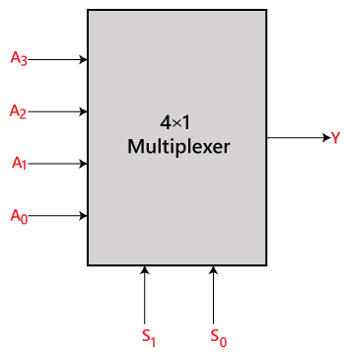
Block Diagram of 4×1 Multiplexer

Slide 10
Truth Table 4×1 Multiplexer:
Selection lines |  | INPUTS |  |  |  | OUTPUT
S₀ | S₁ | A₀ | A₁ | A₂ | A₃ | Y
0 | 0 | 1 | 0 | 0 | 0 | A₀
0 | 0 | 0 | 1 | 0 | 0 | A₁
1 | 1 | 0 | 0 | 1 | 0 | A₂
1 | 1 | 0 | 0 | 0 | 1 | A₃

Slide 11
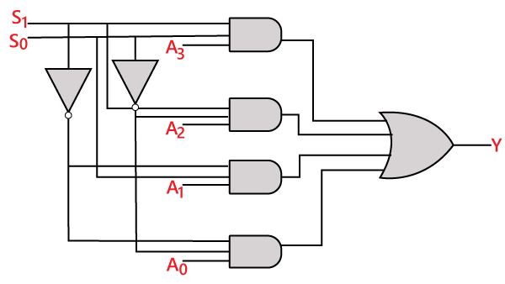
Logic Circuit 4×1 Multiplexer

Slide 12
De-multiplexer

Slide 13
De-multiplexer
A De-multiplexer is a combinational circuit that has only 1 input line and 2^{N} output lines.
De-multiplexer is opposite to the multiplexer.
De-multiplexer is also treated as De-mux.

Slide 14
Types of De-multiplexer
1×2 De-multiplexer
1×4 De-multiplexer
1×8 De-multiplexer
1 x 16 De-multiplexer

Slide 15
1×2 De-multiplexer
In the 1 to 2 De-multiplexer, there are only two outputs, i.e., Y₀, and Y₁.
1 selection lines, i.e., S₀.
and single input, i.e. A.
Enable input E.

Slide 16
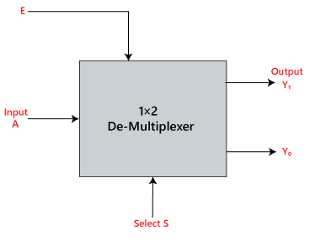
Block diagram of 1×2 De-multiplexer

Slide 17
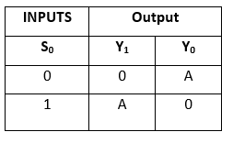
Truth Table of 1×2 De-multiplexer

Slide 18
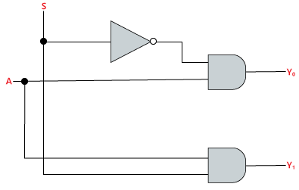
Logic Circuit of 1×2 De-multiplexer

Slide 19
Difference between of Multiplexer and Demultiplexer :
Multiplexer | Demultiplexer
Multiplexer is a digital switch. | Demultiplexer is a digital circuit.
It is known as Data Selector. | It is known as Data Distributor.
It has n data input | It has single data input.
It has a single data output. | It has n data outputs.
It works on many to one operational principle | It works on one to many operational principle.

Slide 20
Download ppt’s and handwritten notes
JP Web devolpers
Follow on instagram:-@jpwebdevelopers
Thank
you

